Slide 1
CREDIT RISK ANALYSIS
SUBMITTED BY….. ANOUSKA PATNAIK & CM VIJAYA KUMAR

Slide 2

EDA
Exploratory data analysis is an approach of analyzing data sets to summarize their main characteristics, often using statistical graphics and other data visualization methods. A statistical model can be used or not, but primarily EDA is for seeing what the data can tell us beyond the formal modeling or hypothesis testing task.

Slide 3
Problem Statement
When the company receives a loan application, the company has to decide for loan approval based on the applicant’s profile. Two types of risks are associated with the bank’s decision:
If the applicant is likely to repay the loan, then not approving the loan results in a loss of business to the company.
If the applicant is not likely to repay the loan, i.e. he/she is likely to default, then approving the loan may lead to a financial loss for the company.

Slide 4
AIM OF THE CASE STUDY
This case study aims to identify patterns which indicate if a client has difficulty paying their installments which may be used for taking actions such as denying the loan, reducing the amount of loan, lending (to risky applicants) at a higher interest rate, etc. This will ensure that the consumers capable of repaying the loan are not rejected.

Slide 5
DATA SETS USED
1)Application_data.csv:
Contains all the information of the client at the time of application.
The data is about whether a client has payment difficulties.
2) previous_application.csv:
Contains information about the client’s previous loan data.
It contains the data whether the previous application had been Approved, Cancelled, Refused or Unused offer.

Slide 6
Analysis Approach
Understanding the data set, by Normal check of application data –
info(verbose = True, null counts = True )- it doesn't display all the columns. So, we have used verbose = True which would display all columns and we need the individual null counts too, so we have used null counts = True.
Shape
Describe()
Performing data quality checks
Finding and analyzing missing values in our data.
Data cleaning of columns having Null values >50%
Removing extra columns
Finding the best measures to impute the missing data
a) Let us take the columns having missing data less than or equal to 14%.
b) For imputing values into the missing columns, its advisable to use mean/median

Slide 7
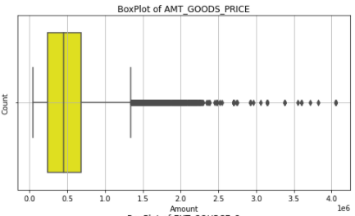
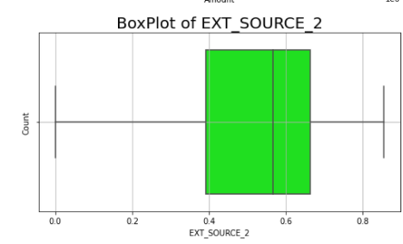
Let us take up some columns and check their plots to analyze and see what values would be suitable for imputing. AMT_GOODS_PRICE-We can replace the outliers with median as these outliers are placed very close to each other. EXT_SOURCE_2-It has no outliers so we can impute the columns using mean.

Slide 8
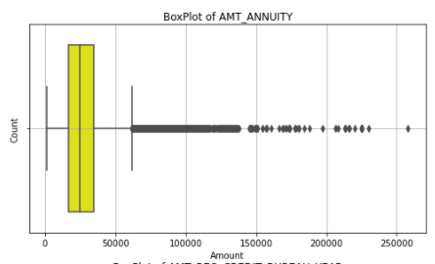
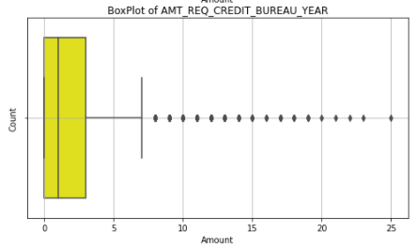
AMOUNT_ANNUITY--There is not much difference between mean and median so we can impute outliers with median values. AMT_REQ_CREDIT_BUREAU_YEAR-Since there are few outliers, we can impute with mean

Slide 9
Examining and modifying the data in some columns:
columns are having Float Data type while containing Integer Data. can be considered for Data type conversion to reduce memory usage.
Clubbing Columns:
The columns related to Flag Documents can be clubbed into one taking the total number of documents submitted to ease our understanding and data analysis.
The Flag columns for modes of communication can be clubbed in the same way.
3) Rectifying negative data from important columns:
Days_birth, Days_employed, Days_Registration , Days_id_publish.

Slide 10
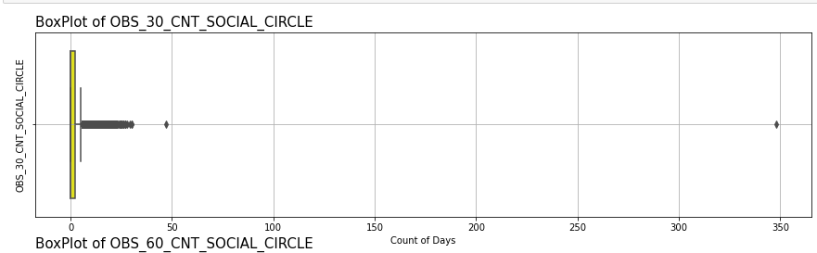
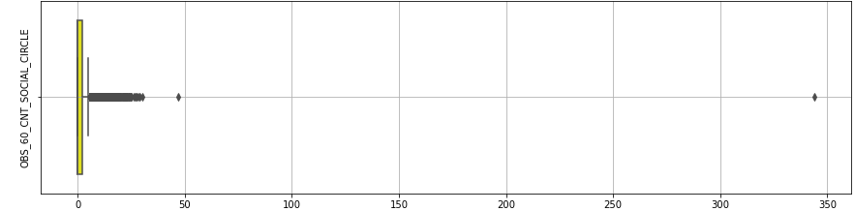
Checking for outliers in our dataset: For OBS_30_CNT_SOCIAL_CIRCLE & OBS_60_CNT_SOCIAL_CIRCLE-There exists one record with an extreme outlier which can be detected to ease our analysis.

Slide 11
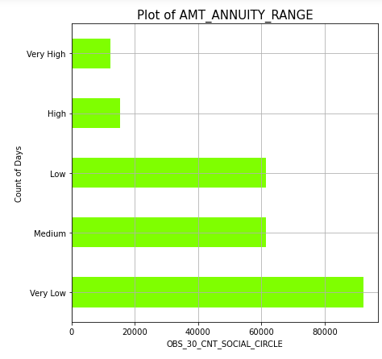
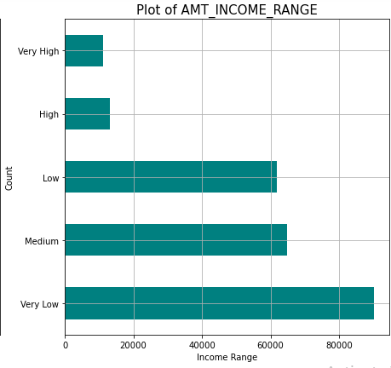
Binning Data for further analysis: There are certain columns that contain data which can be put into bins for better understanding the data. we are binning AMT_ANNUITY and AMT_INCOME_TOTAL.

Slide 12
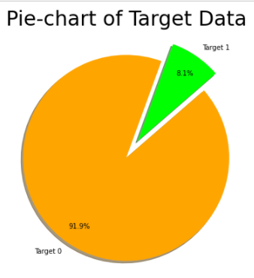
Checking the Imbalance Percentage Let us consider the column Target. Here we can see that most of the data is for Target 0 which means most clients (91.92%) don't have payment difficulties while the rest are facing some or the other payment difficulties.

Slide 13
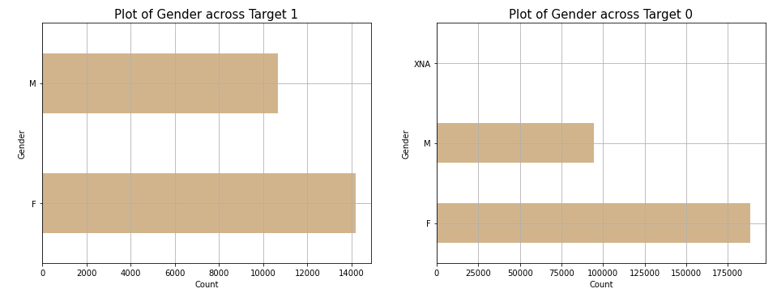
The Analysis/Visualization/Inference
Univariate Analysis on the (categorical data): Gender Vs Defaulter & Non-Defaulter
Here we can see for Gender there's another data - "XNA" about which we are not sure if that's NaN or it means the option "Prefer Not to Say"
We can see that the count of females is higher than Males irrespective of having payment difficulties or not

Slide 14
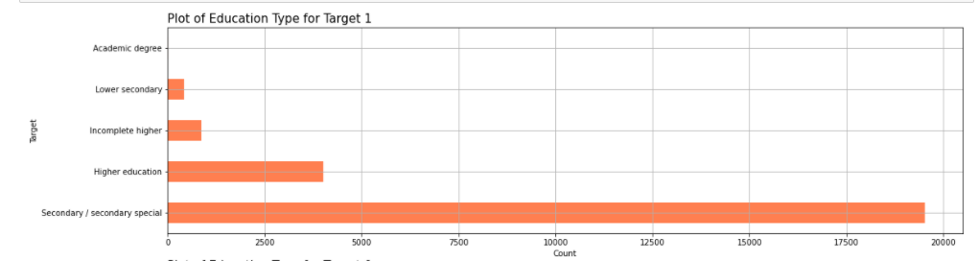
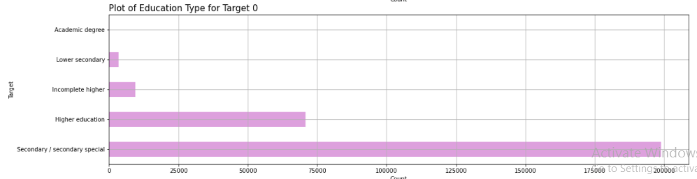
Univariate Analysis on the (categorical data): Name of Education type Vs Defaulter & Non-Defaulter Here we can see that a high number of people having Secondary/Secondary Special education type have the most number of applications followed by people having completed higher education.

Slide 15
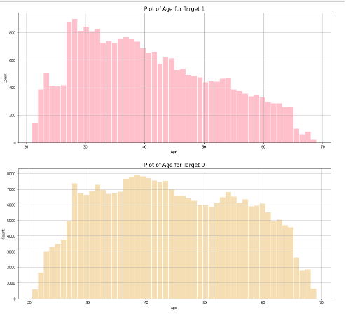
Univariate Analysis for (Continuous Data): 1)People falling under Target - 1 are most likely to be of the age 25-35, i.e. most likely to be having issues with payment. 2)People falling under Target - 0 are most likely to be of the age 27-60 which signifies that age has a relation between the ability to make the payment.|

Slide 16
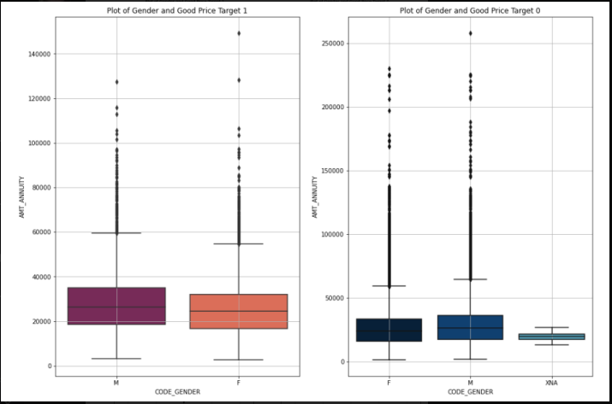
Bivariate Analysis for Continuous ~ Categorical Data: "CODE_GENDER“ Vs "AMT_GOODS_PRICE“ 1) Here we can see that males in target-0 category are most likely to have more price of goods. 2) Its almost same for both males and females of Target-1to have the similar counts and many outliers for goods price.

Slide 17
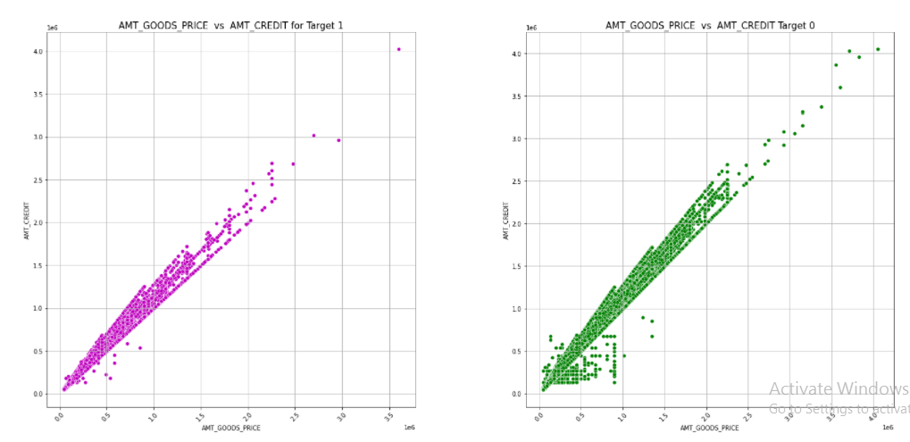
Bivariate Analysis for Continuous ~ Continuous Data: AMT_GOODS_PRICE Vs. AMT_CREDIT 1) We can see a clear direct proportionality between Amount Credit and Goods Price which implies, credit amount depends on the goods price. 2) For people with payment difficulties, i.e. Target 1 , they are likely to have comparatively less total income than those in Target 2.

Slide 18
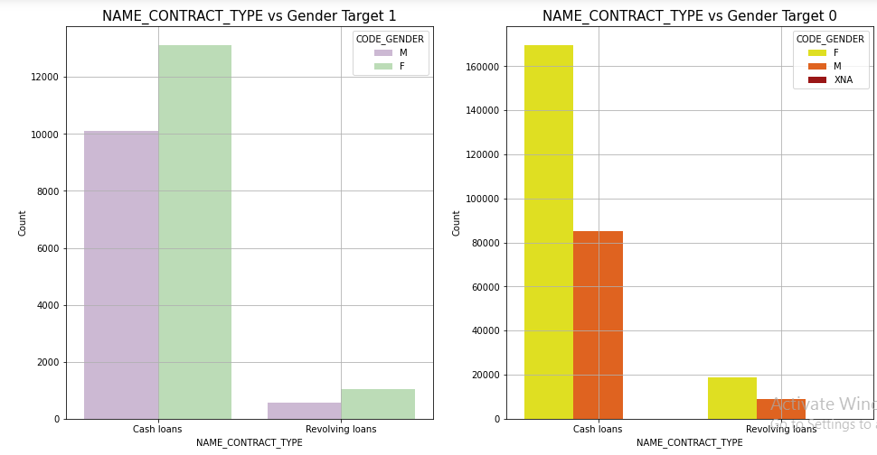
Bivariate Analysis for Categorical ~ Categorical Data: NAME_CONTRACT_TYPE Vs. Gender 1) People are more likely to take Cash loans than resolving loans. 2) Females in both cases are more likely to take loans than the males, almost double in Target 0 category

Slide 19
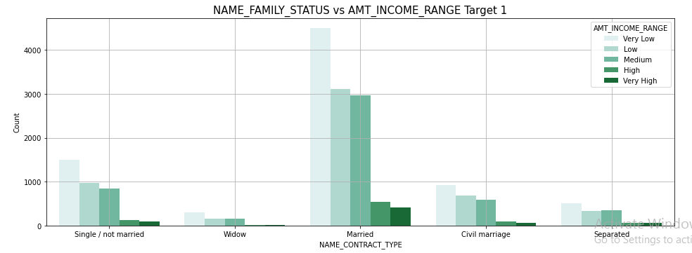
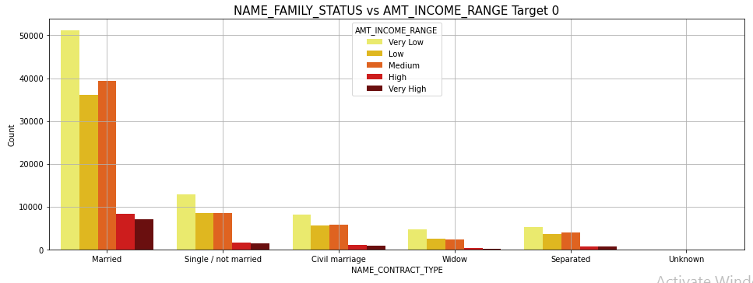
Bivariate Analysis for Categorical ~ Categorical Data: NAME_FAMILY_STATUS Vs. AMT_INCOME_RANGE 1) Married and Very Low income people are most likely to apply for the loans 2) Widows are least likely to apply for loans 3) Out of the very high income, most are married|

Slide 20
Finding Correlation for Numerical Columns

Slide 21
Reading and analyzing data in Previous Application Data:
Upon checking the previous data we found many values as XNA, so we are here taking it and filling with NaN.
Merging the data sets I.e. previous application data and application data.
Performing Analysis after Merging:
a) Univariate Analysis Categorical data.
b) Univariate Analysis Continuous data.
c) Bivariate Analysis for Continuous ~ Categorical Data
d) Bivariate Analysis for Continuous ~ Continuous Data
e) Bivariate Analysis for Categorical ~ Categorical Data

Slide 22
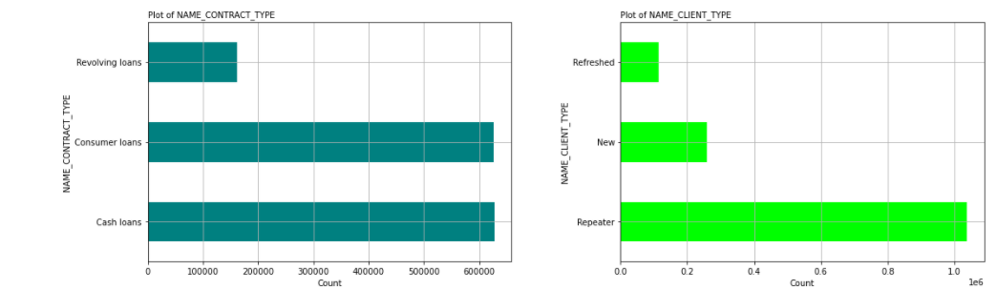
Univariate Analysis for Categorical data: a) Almost equal number of Cash Loans and Consumer Loans have been applied for; Least Resolving Loans have been applied for b) Most of the clients have been Repeaters.

Slide 23
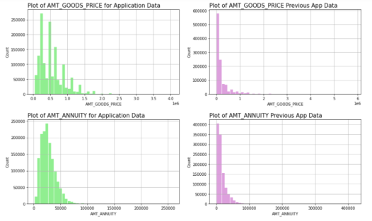
Univariate Analysis for Continuous data: AMT_CREDIT – For application data, most of the amounts lie in the range up to 2000000 while we can clearly see that most people in previous applications have the amounts more in the range up to 15000000. AMT_ANNUITY - For both the data, Amount Annuity has been pretty similar but in previous data, there are extreme outliers. AMT_GOODS_PRICE - For both the data, Amount of Goods has been pretty similar but in previous data, there are more outliers.

Slide 24
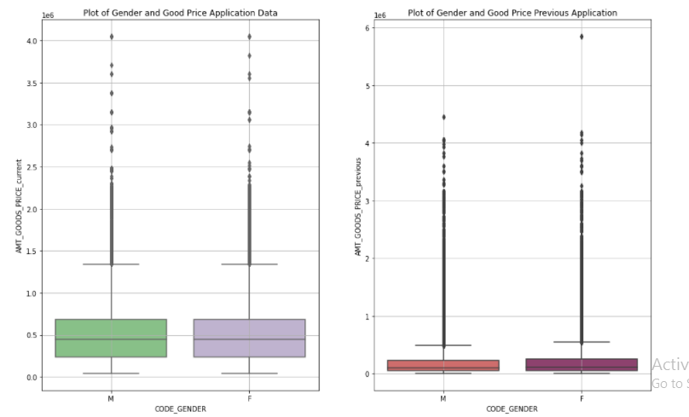
Bivariate Analysis for Continuous ~ Categorical Data In application data, males and females are likely to have applied with max Goods Price ranging till more than 400000 while in Previous Application data, max values for females are ranging up to more than 500000 There are comparatively more outliers for the Previous Application data considering Gender vs Goods Price in Application data, max Annuity Amounts have been for Males ranging up to 250000 and more while in Previous Applications, males and females both are having max Annuity amounts ranging more than 400000

Slide 25
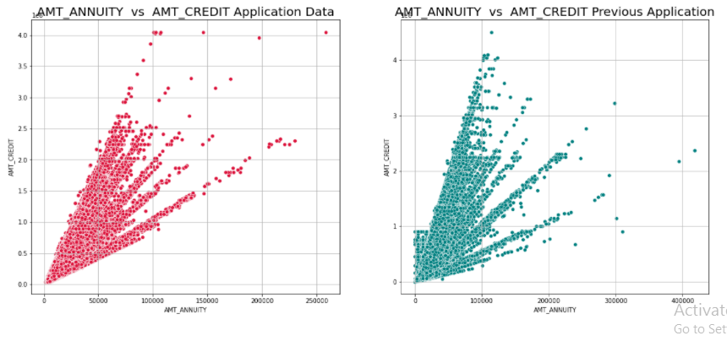
Bivariate Analysis for Continuous ~ Continuous Data: we can see that Amount Annuity is having a good correlation with Amount Credit in both the case.

Slide 26
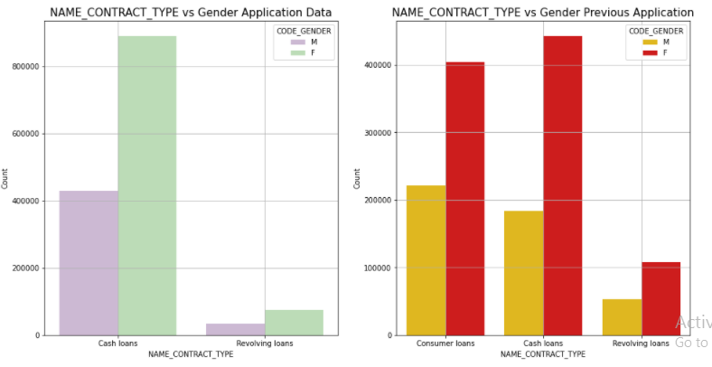
Bivariate Analysis for Categorical ~ Categorical Data 1)Females have more applied for loans as compared to males. 2)Cash loans have been more preferable in application data or previous data. 3)People are least likely to apply for revolving loans.

Slide 27
Conclusion
The proportion of defaulters is 8%.
Bank should give more revolving loans as people with revolving loans are less like to default.
Consumer loan are mostly like to approve by bank.
Age and Education is important factor as older people and higher the education level are less likely to default.
Females are less likely to default compared to males.

